Slide 1
Make the Most of your Advocacy Efforts

Slide 2
What is RESULTS?
2
RESULTS is a movement of passionate, committed everyday people. Together we use our voices to influence political decisions that will bring an end to poverty.

Slide 3
RESULTS Successes
3
For 40 years, RESULTS volunteers have been advocating for policies that expand opportunity and reduce poverty for people around the globe. In that time, policies RESULTS has helped enact have:
Cut in half the number of children who die from preventable disease
Expanded tax credits for working families that lift over 8 million people above the poverty line each year
Helped save 27 million lives through advocacy for the Global Fund to Fight AIDS, TB and Malaria
Protected and expanded access to food assistance (SNAP), which serves 40 million people per month

Slide 4
4

Slide 5
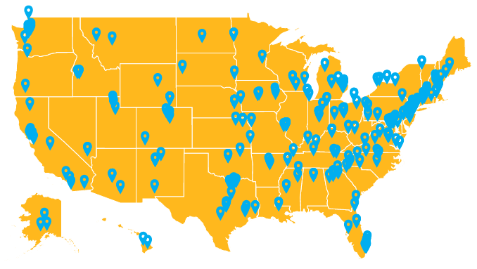
5
RESULTS First 100 Days Campaign: 306 lobby meetings

Slide 6
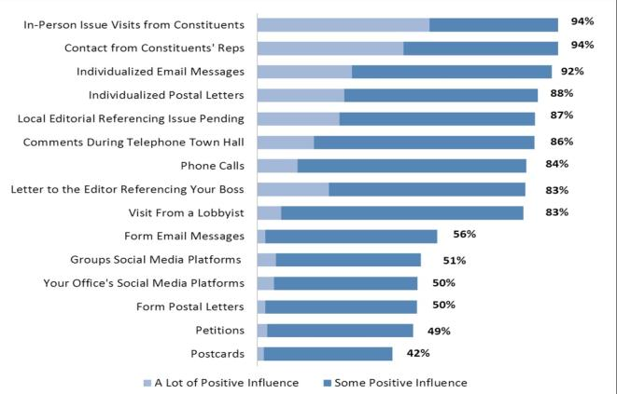
Advocacy Works!
6
If your member of Congress has not already come to a decision on an issue, how much influence do the following advocacy strategies have:
Source: Congressional Management Foundation, 2017

Slide 7
What qualifies you to be an advocate?
7
Being alive

Slide 8
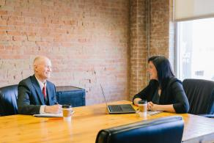
What qualifies you to be an advocate?
8

Slide 9
Effective advocacy is always personal
9
You have a story to tell, even if you don’t know it yet

Slide 10
Advocacy Works!
10
If your member of Congress has not already come to a decision on an issue, how much influence do the following advocacy strategies have:
Source: Congressional Management Foundation, 2017

Slide 11
If not now, when? If not you, who?
11
Who understands the mental health needs of students better than you?
Who knows the tools needed to help kids navigate these challenges better than you?
Who is equipped to advocate for children better than you?

Slide 12
Influencing Lawmakers – How Do You Do It?
12
How do RESULTS volunteers influence members of Congress?
Sending e-mails
Writing letters (harder now)
Making phone calls
Generating media
Getting to know policy aides and schedulers
Organizing others in your community to take action
Meeting face-to-face with members of Congress
Difficulty
Influence

Slide 13
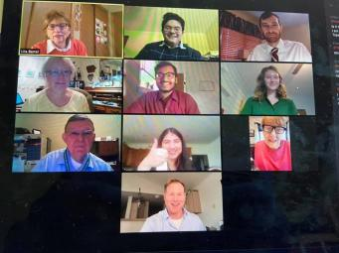
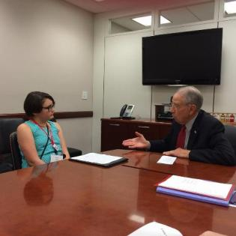
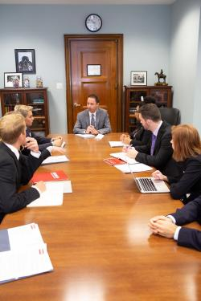
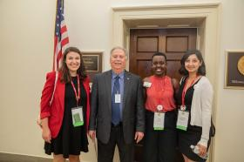
Anyone can do a lobby meeting
13

Slide 14
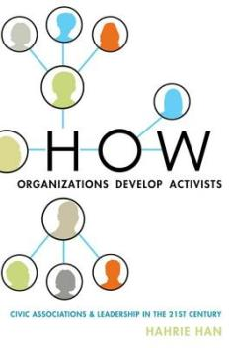
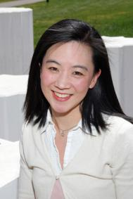
Mobilizing and Organizing
Dr. Hahrie Han
Johns Hopkins University
https://www.hahriehan.com/
How to turn what you have into what you want

Slide 15
Mobilizing and Organizning
Mobilizing
Going wide
Quick, easy actions; top-down approach
Focus is on outcomes
Organizing
Going deep
Actions designed to engage people and build leadership
Focus is on transformation
Effective organizations do both!

Slide 16
Engaging People in Action
Relationship
People are transformed when they are in relationship with others
Design actions that put people in community together
Agency
Competence + Autonomy, i.e. don’t spoon feed actions
Give people flexibility to “make it their own”
Purpose
People want to be part of something bigger than themselves
Want to know that their time is being well spent

Slide 17
What it looks like in practice
Relationship
Host webinars and trainings to bring people together
Organize call-in days and lobby days centered around a theme or issue
Follow up afterward to share about the experience
Agency
Schedule meetings, share stories
May need to hand-hold at beginning but with goal of letting go
Purpose
Be clear about what’s at stake
Articulate your goal and what their role is in reaching it
Keep people updated on progress

Slide 18
Additional tips for success
Create a sense of urgency
If people don’t think it’s important now, they won’t take action
Focus on benefit, not cost
It’s not how much time it will take, but how worthwhile the experience is
Solicit feedback
During and after campaign, check in on people’s experience
Show gratitude
Always thank people for their efforts

Slide 19
Preparing for your Virtual Lobby Meeting
Practice, practice, practice
Write out your part and practice (Laser Talks)
If possible, gather online to practice and test technology
Focus on cues on when to speak (facilitator important)
Make sure everyone understands the tech (e.g. mute/unmute)

Slide 20
To Speak Powerfully, Be EPIC!
20
ENGAGE
Engage the listener into the conversation
Problem
Identify the problem
Inform
Inform about the solution
Call to Action
Call them into action

Slide 21
21
EPIC Laser Talk Exercise
Start with an introduction
Your name
Where you live? (if they don’t know you)
What is the issue you want to talk about?
Hi Kathleen, would you have a few minutes to talk about a project I’m working on around child poverty.

Slide 22
EPIC Laser Talk Exercise
22
E = ENGAGE the listener into your conversation
What excites me about for this issue?
What am I angry about?
What am I excited about?
Congress just passed legislation that will cut child poverty by 45 percent in the next year through an expansion of the Child Tax Credit.

Slide 23
EPIC Laser Talk Exercise
23
P = Problem
What problem do you want to solve?
Be specific and make sure it’s a problem the listener address
However, unless advocates speak up now, these provisions will expire next year, pushing millions of children back into poverty.

Slide 24
EPIC Laser Talk Exercise
24
I = Inform or Illustrate
Why is this issue important? What is your solution the problem?
Provide details that expand on the problem and/or it’s solution.

Slide 25
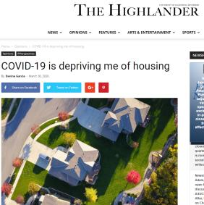
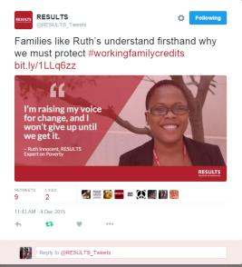
Tell stories
25
Stories matter and…they work!
“Data makes you credible. Stories make you memorable.”
Stories are “sticky” – 22x more likely to be remembered than facts alone
Effective way to influence policy makers, bust dangerous myths

Slide 26
EPIC Laser Talk Exercise
26
I = Inform or Illustrate
We have the opportunity to cut child poverty in half in this country by making the new CTC provisions permanent. But without ordinary people like me and you telling our members of Congress to do it, it won’t happen. I know you care deeply about issues affecting children and have seen you speak out about it on social media. I think you would be a powerful advocate on this issue.

Slide 27
EPIC Laser Talk Exercise
27
C = Call to Action
What do you want the listener to do?
Be as specific as you can. Frame it as a YES or NO question.
I am working on a new campaign to make the CTC provisions permanent this year. We’re organizing people to take action in the coming weeks. I would love for you to be part of this. We’re going to make history. Would you join us?

Slide 28
28
EPIC Laser Talk
Engage: Congress just passed legislation that will cut child poverty by
45 percent in the next year through an expansion of the Child Tax Credit.
Problem: However, unless advocates speak up now, these provisions will expire next year, pushing millions of children back into poverty.
Inform: We have the opportunity to cut child poverty in half in this country by making the new CTC provisions permanent. But without ordinary people like me and you telling our members of Congress to do it, it won’t happen. I know you care deeply about issues affecting children and have seen you speak out about it on social media. I think you would be a powerful advocate on this issue.
Call to Action: I am working on a new campaign to make the CTC provisions permanent this year. We’re organizing people to take action in the coming weeks. I would love for you to be part of this. We’re going to make history. Would you join us?

Slide 29
29
Questions?

Slide 30
Resources
30
RESULTS Advocacy Basics
https://results.org/volunteers/advocacy-basics/
RESULTS Training Resources
https://results.org/volunteers/training-webinars/
RESULTS Online Actions
https://results.org/volunteers/action-center/
Staff Support:
Jos Linn, jlinn@results.org, (202) 783-4800, x. 203

