Slide 1
Suicide Prevention: education and awareness
SUICIDE PREVENTION PROGRAM
DEPARTMENT OF VETERANS AFFAIRS
Julia Pawlenty LICSW

Slide 2
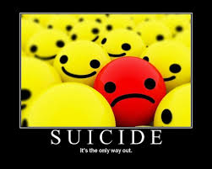
Why talk about suicide?
20% of us will be impacted by suicide within our immediate family
60% of us will personally know someone who has died by suicide
“Prevention may be a matter of a caring person with the right knowledge being available in the right place at the right time.”
(American Foundation For Suicide Prevention)

Slide 3
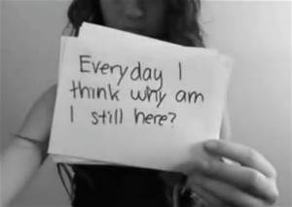
What is your experience with suicide?
Professional?
Personal?
Stigma?

Slide 4
Objectives
Suicide in the United States
Suicide in MN
Population specifics
Learn the risk factors, warning signs, protective factors
How to ask the question
Resources

Slide 5
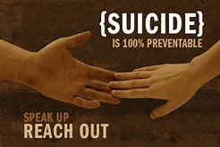
Suicide: world health crisis
804,000 deaths from suicide occurred worldwide in 2012
More than 42,000 US deaths from suicide each year

Slide 6
SUICIDE: WORLD HEALTH CRISIS
Every approx. 13 minutes, someone dies by suicide
An estimated one million people attempt suicide each year
One attempt every 35 seconds
Suicide is the 10th leading cause of death in the U.S.

Slide 7
SUICIDE: WORLD HEALTH CRISIS
Ethnic groups – of every 100,000 people in each ethic group, the following number died by suicide
White males-25.8 per 100,000
Native Americans-16.39 per 100,000
Hispanics-10.98 per 100,000
Black males-9.64 per 100,000
Asian/Pacific Islander-8.74per 100,000
Gender disparities
Women attempt suicide 3 times more than men
Men complete suicide almost four times that of women
Methods
Firearms 51%
Suffocation/Hanging 24%
Poisoning 16%
Cutting 2%
Drowning 1%

Slide 8
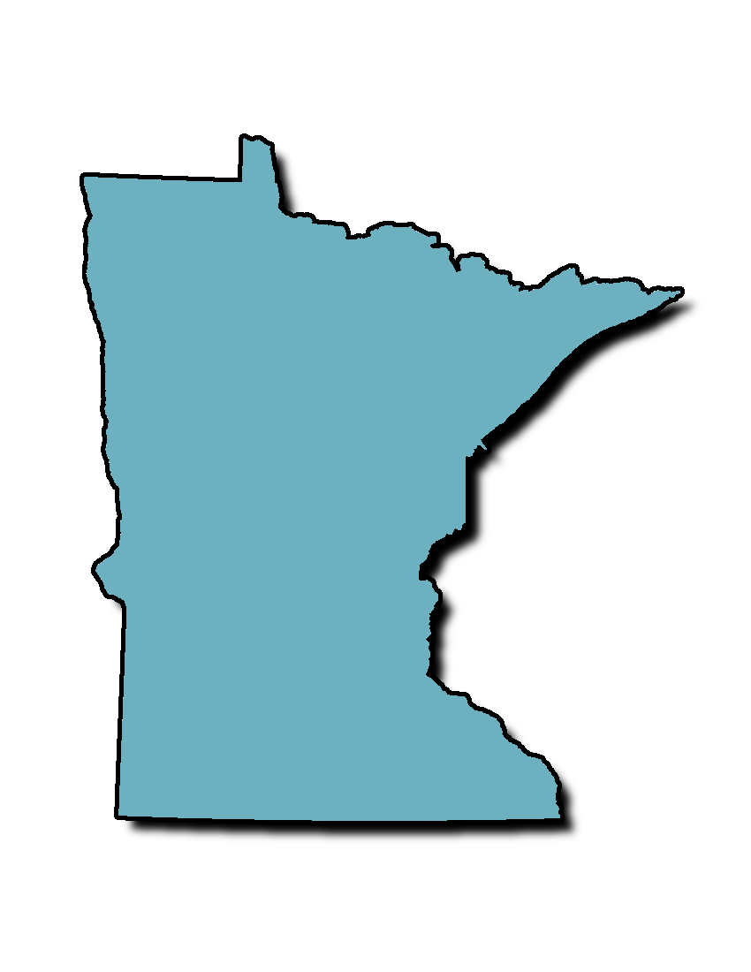
SUICIDE IN MINNESOTA
In 2015, 730 people died by suicide
Suicide is the 9th leading cause of death in MN
One person dies by suicide every 12 hours in MN
Notes:
Homicide is the 15th leading cause of death in the US-remember, suicide is the 10th!

Slide 9
Suicide among pre-adolescents
What we know…
Pre-adolescents lack abstract thinking skills – finality of death
Young children are inherently impulsive
Lack of cognitive skills to realize the fleetingness of many of their troubles (APA, 2010)
Pre-adolescents have a murky understanding of death
Suicide among children is RARE…
Less than 2 out of every one million children ages 5-11 will die by suicide
The rate among adolescents ages 12-17 is approx. 52 per million
Approx 33 children under age 12 kill themselves each year in the US. (Bridge et al., 2015)

Slide 10
Suicide among pre-adolescents
Do kids even know what suicide is?
Interview of 65 elementary school children revealed all knew what “killing oneself” meant
By third grade, all but one child understood the word “suicide”
-Mishara, Founder of the Centre for Research and Intervention on Suicide and Euthanasia

Slide 11
Suicide among pre-adolescents
The Research Institute at Nationwide Children's Hospital in Columbus OH collected national data on children (ages 5-11) and young adolescents (ages 12-14) who died by suicide between 2003-2012 …
Both groups had more boys die than girls
The most common method of suicide was hanging/strangulation/suffocation followed by firearms
In both groups, almost all of the deaths occurred at home, between the hours of noon and midnight
In both groups, relationship problems were linked to suicide. School problems and recent crises were other common triggers.
One-third of both children and adolescents who died had a mental health diagnosis
Children: ADHD Adolescents: Depression
Only one-third who died by suicide told anyone that they intended to kill themselves

Slide 12
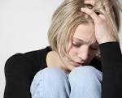
SUICIDE AMONG YOUNG PEOPLE
In MN,
Second leading cause of death for age 15-34
Third leading cause of death for age 10-14
Third leading cause of death for those under 24 in US
In 2015, 5,491 young people age 15-24 died by suicide.
7.8 percent attempted suicide one or more times

Slide 13
Suicide among LGBTQ population
LGBTQ students and students unsure of their sexual orientation were approximately 4 times more likely to have attempted suicide in the past year than their straight peers
Each time an LGBTQ person is a victim of physical or verbal harassment or abuse, they become 2.5x more likely to hurt themselves.
Approx. 30% of adults and young adults who identify as transgender reported having ever attempted suicide compared to 4.6% of adults and young adults in the general population (Kessler et al study, 1999)
We do not know whether more LGBT youth die by suicide than straight youth as sexual orientation/gender identify data is not included on death certificates and often does not show up in psychological autopsy interviews.

Slide 14
Risk factors
Demographics
Tangible events
Life changes
Change in circumstances

Slide 15
Risk factors
Many people have one or more risk factors, but are not suicidal
It is the cumulative and interactive effects of co-occurring risk factors that result in increased risk for suicide behavior

Slide 16
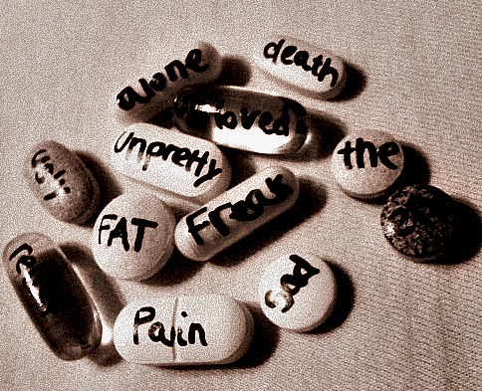
Risk Factors
Previous suicide attempt(s)
History of psychiatric hospitalizations
Discrimination, Bullying, Harassment
History of mental illness
Self-injurious behavior
Alcohol or substance abuse
Recent loss
Low self-esteem
Exposure to friend/family suicide
History of abuse
Repeated exposure to pain/suffering/trauma
Hopelessness
Impulsivity
Interpersonal conflict/stress
Family rejection
8x more likely to have attempted suicide than those with supportive families
Access to weapons or other means
Notes:
Impact is determined more by the person’s interpretation of the stressor than the nature of them.

Slide 17
Warning signs
Changes in behavior
Actions or gestures
Risky behaviors
Verbal expressions

Slide 18
Signs that require immediate action & safety measures….
Someone wanting to hurt or kill themselves, or talking of wanting to hurt or kill him/herself
Someone looking for ways to kill themselves by seeking access to the means
Someone talking or writing about death, dying or suicide when these actions are out of the ordinary for this person

Slide 19
other warning signs
Hopelessness
Co-occurring mental health concern
Feeling lack of purpose
Rage or anger
Impulsiveness
Loss of interest in hobbies, interests
Sleeping too much or too little
Increased use of drugs or alcohol
Withdrawing from family and friends
Mood swings
Sudden shift from deep depression and thoughts of death to cheerfulness or peace
Giving away prized possessions
Putting personal affairs in order
Notes:
Peacefulness right before attempt….

Slide 20
VERBAL CUES
“I wish I was dead”
“They would be better off without me”
“I won’t be around much longer”
“Pretty soon you won’t have to worry about me”
“Who cares if I am dead anyway”
“I’m just going to end it all”

Slide 21
Protective factors
Serve as buffer to risk factors….
Enhance resilience….
May outweigh risk….
Vary depending on the individual….

Slide 22
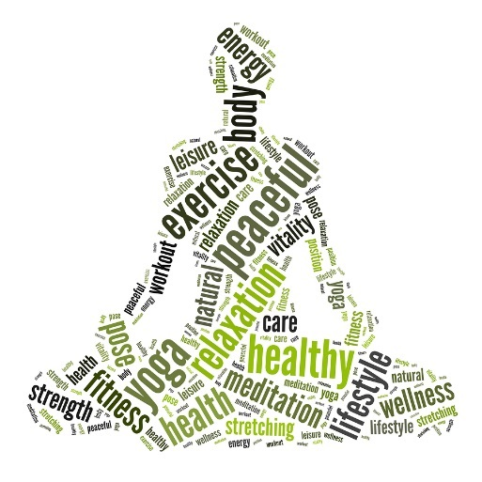
PROTECTIVE FACTORS
Family acceptance and connectedness
Support network (caring adults, school safety)
Access to services
Engagement with health professionals (MH, CH, PC)
Self-help groups
Spiritual/Religious beliefs
Career or Education goals
Planning for the future
Hobbies
Pets
Self-esteem
Problem solving skills
Adaptive coping mechanisms
Difficult access to means

Slide 23
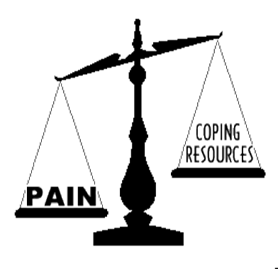
You are concerned someone is at risk for suicide…
What are your next steps?

Slide 24
CONSIDER THE FOLLOWING WHEN TALKING WITH SOMEONE AT RISK FOR SUICIDE…
If in doubt, ask the question
Remain calm
Stay with the person or remain on the phone
Maintain eye contact
Act with confidence
Use open body language
Let them do the talking
Do not worry about doing or saying exactly the ‘right’ thing. Your genuine interest is what is most important.
Be supportive and encouraging
“You mean a lot to me and I want to help”
Offer HOPE!
Notes:
If on the phone, do not hang up….get in touch with a colleague to determine whether a welfare check is clinically indicated

Slide 25
Asking the question… indirect/direct
Indirect:
“Have you been feeling down lately?”
“Sometimes when people are as upset as you seem to be, they sometimes wish they were dead. I am wondering if you feel that way too?”
*Vague question gets a vague answer*
Direct:
“Are you thinking about killing yourself?”
“Are you thinking of suicide?”
“Have you thought about harming yourself?”
“Under such circumstances, it is better to be bold and blunt than shy and sorry” -Quinnett
Notes:
How do you feel about suicide?

Slide 26
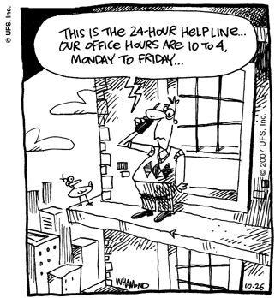
How Not to ask the question…
“You’re not suicidal, are you?”
Notes:
Approaching it this way---reinforces stigma---reinforces judgment---does not create an environment of safety or comfort

Slide 27
What if they say no?
Explain why you asked
Telling them why you asked may change their answer
Provide resources
They may benefit later
Get others involved
Could prevent a crisis

Slide 28
What if they say yes?
Listen
Hear their story
Give them your full attention
Offer hope
“I want to help you” or “I want you to live”
Ask
“Do you have a plan?”
“Do you have access to the means to carry out your plan?”
“How intent are you in ending your life?”
Act
Do not leave the person alone!
Get others involved (SW, Counselor, 911, Crisis Response, Parents etc)
Provide resources (crisis hotline, community resources)
Notes:
If you are on the phone, don’t hang up-get help from someone around you to initiate a welfare check if needed

Slide 29
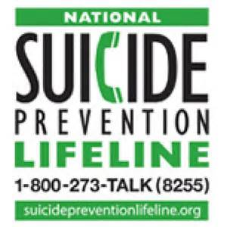
KNOW THE RESOURCES
National Suicide Prevention Hotline 1-800-273-TALK(8255)
County Crisis Response Unit
Crisis Connection Minnesota 612-379-3636
Suicide Awareness Voices of Education www.SAVE.org
Suicide Prevention Resource Center www.SPRC.org
American Association of Suicidology
The Trevor Project www.thetrevorproject.org
TXT4Life
Emergency Department
United Way – 211

Slide 30
Responding to suicide risk…
Remove or secure lethal means
Get others involved
Staff – Family, etc.
Offer HOPE!
Safety Plan
Reinforce healthy coping skills
Stay connected
Check back in– continue to offer support

Slide 31
HOPE BEGINS WITH YOU!
Notes:
The Ripple Effect
As education increases….prevention increases!!!!! You learned today, you teach your friends, family, colleagues of suicide awareness and prevention, they teach….and so on, creating the ripple effect

Slide 32
Thank you!
Julia Pawlenty, LICSW
612-467-2742

