Slide 1

Check-In / Check-Out:
A Tier 2 Behavior Intervention
Kevin J. Filter, Ph.D.
Minnesota State University, Mankato
MSPA Midwinter 2018

Slide 2

Presentation Overview
Intro to Tier 2 and CICO
Research Support
Implementation Basics
Modifications
Systems-level Implementation

Slide 3
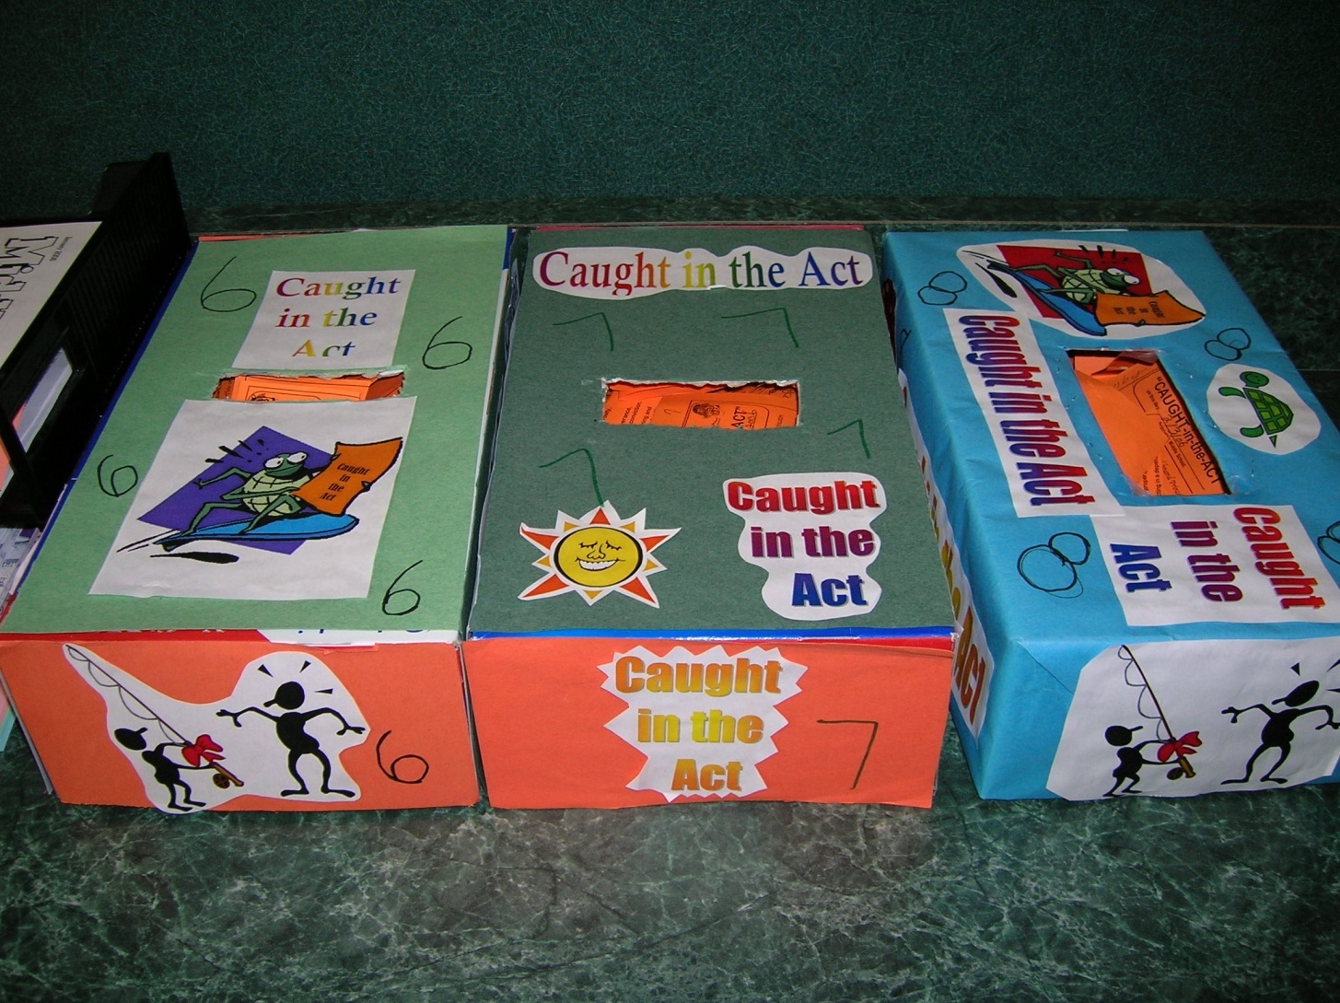


PBIS Core Components
Level 1 – Incidental Infractions Non-referred/Non-recorded | Level 2 – Minor Infractions Non-referred/Recorded | Level 3 – Major Violations Referred/Recorded | Level 4 – Illegal Violations Referred/Recorded
Running Loud voices/yelling Hallway loitering Off-task behavior Name calling Noise making Uncooperative Out of seat Missing homework Disruptive Breaking cafeteria rules Breaking playground rules Inappropriate behavior in the bathrooms Chewing gum or eating candy inappropriately Other: | Disrespectful Lying/cheating Indirect, inappropriate language/gestures Inappropriate dress Spitting Third Level-1 offense Cell phones and misuse of other electronic devices Other: | Direct, inappropriate language/gestures Fighting/physical aggression Harassment/bullying Overt defiance Obscene gestures Property destruction/ misuse Theft Forgery Internet misuse/cyber-bullying Skipping class “Pantsing” Third Level-2 offense Reference in conversation, writing or pictures to weapons or acts of violence Throwing objects with intent to harm Biting Leaving area without permission Racial, ethnic, religions or sexual slurs Other: | Drug use/possession Weapon use/possession Truancy Arson Bomb threat Extreme property damage/vandalism Combustibles Assault/threats Other:

Slide 4
Need for Tier 2 Supports
Traditional Model
Kids aren’t dichotomies (good/bad; need help/don’t need help) so why would our systems of support be dichotomous?
MTSS Model
TIER 2
CICO
Team

Slide 5
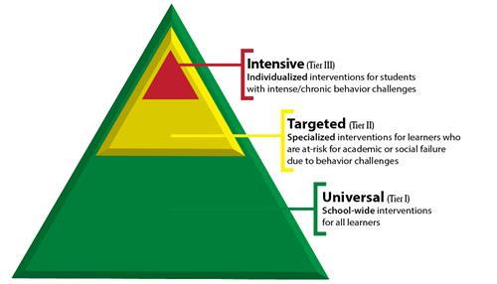
MTSS System (PBIS)

Slide 6
What is CICO?
Designed as a tier 2 intervention for students with at-risk behavior
Significant research support
Simple design but requires substantial planning and effort to implement at a scale of significance.

Slide 7
Student Recommended for CICO
Check in/ Check out (CICO)
CICO Implemented
Morning
Check-In
CICO Coordinator
Summarizes Data
for Decision Making
Parent
Feedback
Regular Teacher
Feedback
Biweekly Meeting
to Assess Student
Progress
Afternoon
Check-Out
Revise
Program
Graduate
Program
Notes:
Student recommended for BEP by Teacher, parent, other school personnel?
Prior to BEP implementation- meeting with Counselor, parent and student
Go over expectations for each party (parent, school, and student)
Set goal
Sometimes contract is signed (I don’t know if you this was ever used Kelly)
3) BEP Implemented
4) Morning check-in
What did you check for? Pencil, binder, agenda, BEP form from day before
Gave students supplies if they did not have them to help them be successful
BEP Daily progress report given (can flip to next slide to show)
Teacher Feedback
Student carries card to teachers
Teachers have been trained to provide some sort of positive interaction upon receiving the card
-Teachers have also been trained not to use the system as punishment- no nagging
Afternoon check-out
BEP coordinator checks for goal
Reinforcement for checking out (High 5)
Bigger reinforcement for checking out and meeting goal (snack)
Parent Feedback
Send home- student gets feedback from parent
Student brings back form signed the next day
BEP Coordinator Summarizes Data for Decision Making
Using Quattro pro Spread sheet program- graphs data
Weekly BEP Meeting
½ hour to assess progress
who attends meeting
decisions made in meeting

Slide 8
Research Support

Slide 9
Early Studies
March and Horner (2002)
  Designed and implemented as a collaboration between Fern Ridge Middle School and Univ of Oregon
  CICO effective for half of at-risk student (12 out of 24)
    The rest required FBA-based modifications
Hawken (2006)
  70% in middle school experienced reductions in ODRs
Filter et al (2007)
  67% in elementary experienced reductions in ODRs

Slide 10
Single-Subject Design Research
Hawken and Horner (2003)
  Multiple-baseline with direct observation
  4/4 MS students showed significant behavior reductions
  Results less clear for academic engagement
Campbell et al (2013)
  ABAB
  3/3 elementary students improved behavior
  2/3 improved academic engagement

Slide 12
Group Designs
Quasi-experimental
  Pre-post comparisons
    Filter et al (2007)
    Hawken et al (2011)
Experimental
  Simonsen, Myers, and Briere III (2011)
  32 MS students assigned to CICO or standard counseling
  CICO significantly better based on direct observation (off-task) and ODRs

Slide 13
Syntheses/Meta-analyses
Maggin et al (2015)
  8 out of 17 article met standards of What Works Clearinghouse
  Studies provided “sufficient empirical support for the CICO program” (p. 205) … but need more group designs
Wolfe et al (2016)
  13 out of 15 met at least 80% of standards of Horner et al (2005)
  “basic CICO is an evidence-based practice for students with attention-maintained problem behavior.” (p. 85)
Mitchell et al (2017)
  Using CEC standards, “several issues suggest that the designation as an EBP is warranted, but with caution and strong encouragement for additional and continued investigation.” (p. 358).

Slide 14
Evidence of Fidelity
Filter et al (2007)
  4 out of 5 feature implemented with 90% integrity in elementary implementing to scale
    54% integrity for home component
    Hawken et al (2006) found same results in MS implementing to scale
Hawken et al (2014)
  90% fidelity when combining all literature on CICO
Hawken et al (2015)
  Found fidelity was 2x greater when schools implemented with many students (11.7%) compared to schools implementing with fewer students (6.6%)

Slide 15
Evidence of Social Validity
Above 5 on 6-point scale for “worth the time” and “recommend to others” (Hawken et al, 2006)
Rating of 4.63 out of 6 when asked about behavior change relative to time and effort to implement (Filter et al, 2007)
More desirable than standard counseling (Simonson et al., 2011)

Slide 16
Implementing Standard CICO

Slide 17
Student Recommended for CICO
Check in/ Check out (CICO)
CICO Implemented
Morning
Check-In
CICO Coordinator
Summarizes Data
for Decision Making
Parent
Feedback
Regular Teacher
Feedback
Biweekly Meeting
to Assess Student
Progress
Afternoon
Check-Out
Revise
Program
Graduate
Program
Notes:
Student recommended for BEP by Teacher, parent, other school personnel?
Prior to BEP implementation- meeting with Counselor, parent and student
Go over expectations for each party (parent, school, and student)
Set goal
Sometimes contract is signed (I don’t know if you this was ever used Kelly)
3) BEP Implemented
4) Morning check-in
What did you check for? Pencil, binder, agenda, BEP form from day before
Gave students supplies if they did not have them to help them be successful
BEP Daily progress report given (can flip to next slide to show)
Teacher Feedback
Student carries card to teachers
Teachers have been trained to provide some sort of positive interaction upon receiving the card
-Teachers have also been trained not to use the system as punishment- no nagging
Afternoon check-out
BEP coordinator checks for goal
Reinforcement for checking out (High 5)
Bigger reinforcement for checking out and meeting goal (snack)
Parent Feedback
Send home- student gets feedback from parent
Student brings back form signed the next day
BEP Coordinator Summarizes Data for Decision Making
Using Quattro pro Spread sheet program- graphs data
Weekly BEP Meeting
½ hour to assess progress
who attends meeting
decisions made in meeting

Slide 18
Five Core Daily Features
Check-In
Daily Point Card
Regular Teacher feedback
Check-Out and Reward Delivery
Home Communication

Slide 19
Morning Check In
Conducted by program coordinator
Friendly greeting
Collect yesterday’s card signed by parent
Set goal
  Same goal for all students?
  Goal progresses as student progresses?
Check-in checklist
Time ≈ 1 min/student

Slide 20
BEP Check-In/Check-Out Record
Date:__________________ BEP Coordinator:_________________
Check-In Check-Out
Student Name | Paper | Pencil | Notebook | DPR parent copy | BEP Score
Jason | √ | √ | √ | √ | 90
Leanne |  | √ | √ |  | 85
Juan | √ | √ | √ | √ | 60
Kiran | √ |  | √ |  | 100
Alexa | √ | √ | √ | √ | 95
Jacey | √ |  | √ | √ | 90
Notes:
What was this used for? How you kept track of whether they had all their materials

Slide 21
Teacher Feedback
The details of the card
How teachers give feedback
Importance of teaching teachers about process
  Semi-annual or annual booster
Time ≈ 15 sec/student at each scoring time

Slide 22
Point Card for Middle School with “Split” Schedule
Notes:
Periods (block schedule) along the top
Goals (along the side) are the school-wide expectations (may need to be individualized for some students)
Rankings – 2 = followed expectation, 1 = so- so, 0 = did not meet expectation

Slide 23
HAWK Report
Date ________ Student _______________Teacher___________________
0 = No 1= Good 2= Excellent | Be Safe | Be Respectful | Be Your Personal Best |  | Teacher initials
 | Keep hands, feet, and objects to self | Use kind words and actions | Follow directions | Work in class
Class | 0 1 2 | 0 1 2 | 0 1 2 | 0 1 2
Recess | 0 1 2 | 0 1 2 | 0 1 2
Class | 0 1 2 | 0 1 2 | 0 1 2 | 0 1 2
Lunch | 0 1 2 | 0 1 2 | 0 1 2
Class | 0 1 2 | 0 1 2 | 0 1 2 | 0 1 2
Recess | 0 1 2 | 0 1 2 | 0 1 2
Class | 0 1 2 | 0 1 2 | 0 1 2 | 0 1 2
Total Points = Points Possible = 50 |  | Today ______________% |  | Goal ______________%

Slide 24
KENNEDY CARD
 |  |  | Name _____________________________________________________
Materials to Class | Worked and Let Others Work | Followed Directions the First Time |  | Teacher | Parent
2 1 No | 2 1 No | 2 1 No | Assignments:
 |  |  | Wow,
2 1 No | 2 1 No | 2 1 No | Assignments:
 |  |  | Wow,
2 1 No | 2 1 No | 2 1 No | Assignments:
 |  |  | Wow,
2 1 No | 2 1 No | 2 1 No | Assignments:
 |  |  | Wow,
2 1 No | 2 1 No | 2 1 No | Assignments:
 |  |  | Wow,
2 1 No | 2 1 No | 2 1 No | Assignments:
 |  |  | Wow,
 |  |  | = _____ Goal = 36

Slide 25
Afternoon Check Out
Conducted by program coordinator
Friendly greeting
Review student’s performance for the day
Record data on same sheet as check-in
Deliver rewards according to reward schedule
Make copy of the Card so one goes home and one stays at school

Slide 26
BEP Check-In/Check-Out Record
Date:__________________ BEP Coordinator:_________________
Check-In Check-Out
Student Name | Paper | Pencil | Notebook | DPR parent copy | BEP Score
Jason | √ | √ | √ | √ | 90
Leanne |  | √ | √ |  | 85
Juan | √ | √ | √ | √ | 60
Kiran | √ |  | √ |  | 100
Alexa | √ | √ | √ | √ | 95
Jacey | √ |  | √ | √ | 90
Notes:
What was this used for? How you kept track of whether they had all their materials

Slide 27
Notes on Developing a
Reinforcement System
Most schools include an opportunity for small daily rewards (note: should always be paired with social praise)
  Snack/candy, sticker, school token, high five
Opportunity to earn larger reward
  Points on a credit card
  Stickers on a chart
Examples of long-term rewards:
  Free time: gym, computer, time with friends
  Lunch with preferred adult
  Coupons to snack bar, movie theater, school store

Slide 28
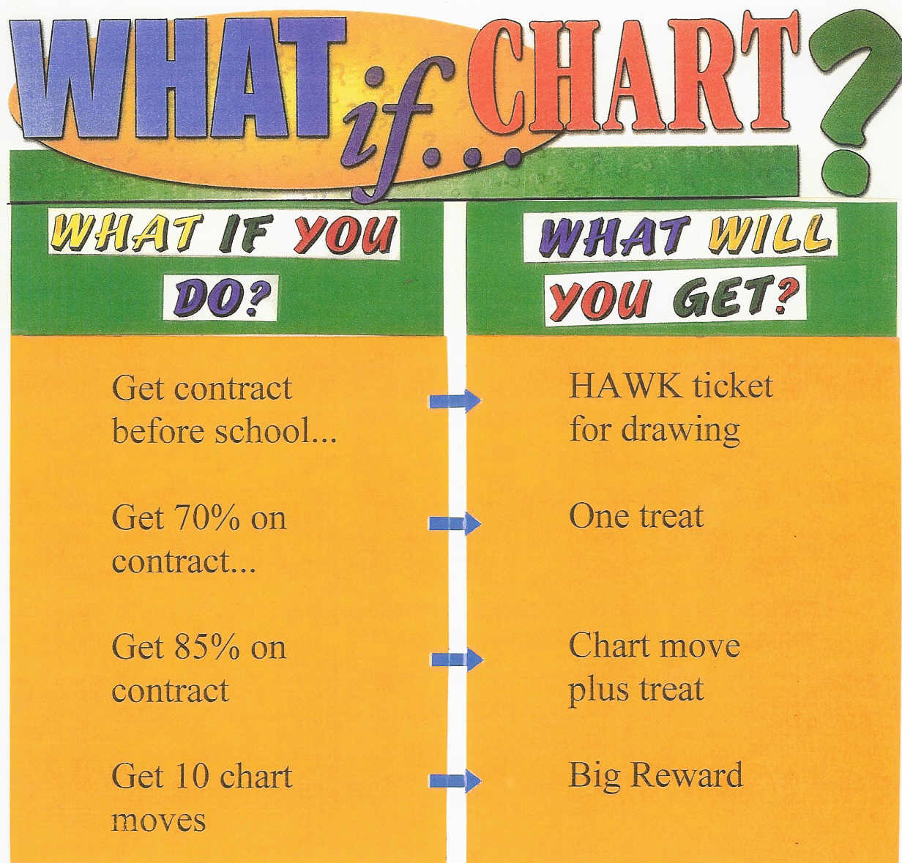

Slide 29
Kennedy Credit Card
1 | 2 | 3 | 4 | 5 | 6 | 7 | 8 | 9 | 10
 |  |  |  |  |  |  |  |  | 20
 |  |  |  |  |  |  |  |  | 30
 |  |  |  |  |  |  |  |  | 40
 |  |  |  |  |  |  |  |  | 50
 |  |  |  |  |  |  |  |  | 60
 |  |  |  |  |  |  |  |  | 70
 |  |  |  |  |  |  |  |  | 80
 |  |  |  |  |  |  |  |  | 90
 |  |  |  |  |  |  |  |  | 100

Slide 30
Kennedy Credit Card
>75% = 1 point on credit card
>85% = 2 points on credit card
>95% = 3 points on credit card
100% = 4 points on credit card

Slide 31
Home Feedback
Parent/guardian training
Parent signs card and returns it
What if card not returned next day?

Slide 32
Plan for fading students off of the intervention
  What are the criteria for fading students off of CICO?
  How will the CICO be faded and who will be in charge of helping students fade off of the BEP?
    Self-management
  How will graduation from the program be celebrated?
  What incentives and supports will be put in place for students who graduate from the program?
    e.g., alumni parties, weekly check-in

Slide 33
Research-Based Modifications

Slide 34
Peer-Mediated/Peer-Led
Benefits
  Adds peer-attention component
  MAY reduce workload for adults
Procedures
  Peers lead or assist with adults during check-in and check-out
  Peers generally at least 2 years older with a pattern of positive behavior (role model)
  Peers require 30 to 90 minutes of training prior to implementation
Collins et al (2016); Melius et al (2015); Dart et al (2015); Sanchez et al (2015)

Slide 35
Internalizing Behaviors and Social Skills
More efficient than other internalizing interventions (e.g., CBT)
Modifications
  Individualize goals to match social skills deficits
  Check-in mentors teach and prompt basic CBT skills such as thought stopping
  15 minutes of group social skills around lunchtime (Ross & Sabey, 2015)
    7 minutes of teaching/modeling and 8 minutes of supervised skill practice during recess
    Social skills homework assigned during check-out
Hunter et al (2014); Collins et al (2016); Dart et al (2015)

Slide 36
Function-Based Modifications
Two approaches: Individualized and Standard Escape
  Individualized
    FBA informs modifications (Fairbanks et al., 2007)
  Standard Escape Modifications
    Breaks Are Better (Boyd & Anderson, 2010)
      2-minute breaks requests (directions printed on back of card)
      Similar to Class Pass intervention (Clay Cook, U of M)
    Escape from supplemental math assignment (Kilgus et al., 2016)
    Extended check-in times to support homework (Turtura et al., 2014)
      MS students could get “opportunity pass” to complete homework

Slide 37
Mid-Day Check Up
Check-in/CHECK-UP/Check-out
  Can earn small reward if earned 50% of daily points
Swoszowski et al. (2013); Sobalvarro et al. (2016)

Slide 38
Team-Managed Full-Scale Implementation

Slide 39


Readiness
Share basic overview with staff BEFORE adopting and training
Staff given opportunity to provide input

Slide 40



Training
Staff
  All staff receive overview training
    Using the point card
    How to give feedback
Parents
  Individual training when child begins program
    What the program is
    How to respond to point card when it comes home
Students
  Individual training when program begins for child
    How, when, and where to check in and check out
    Rating process, Goals, Rewards

Slide 41
Data-based Decision Making
Team devoted to Tier 2 manages CICO
Selection
  2-7 ODRs
Outcomes
  Individual students
  Program
Fidelity

Slide 42
Summary and Resources

Slide 43
Key CICO Messages
Very effective in elementary and MS, emerging evidence in HS
  About 67-75% of students succeed
Should be implemented as a systems-intervention rather than an individualized intervention
  Managed by a team
  Can support 5-15% of student in a school
    Those at-risk
Can be modified to fit needs of school and individual students (non-responders)

Slide 44
Resources
Getting Started Workbook
http://www.pbis.org/common/cms/files/pbisresources/8APBS_Tier2_GettingStartedWorkbook.pdf
CICO Self-Assessment

Slide 45
Resources
Getting Started Workbook
http://www.pbis.org/common/cms/files/pbisresources/8APBS_Tier2_GettingStartedWorkbook.pdf
CICO Self-Assessment
Behavior Education Program
https://www.guilford.com/books/Responding-to-Problem-Behavior-in-Schools/Crone-Hawken-Horner/9781606236000/reviews

Slide 46
Thank you!
Questions?

